Slide 1

An overview of Japan
By,
Chandrima,Durga and Shakib

Slide 2
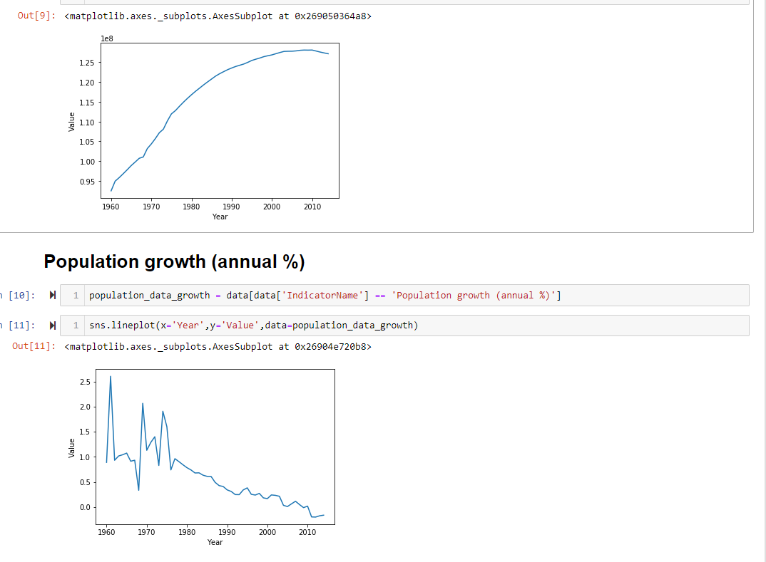
Population

Slide 3
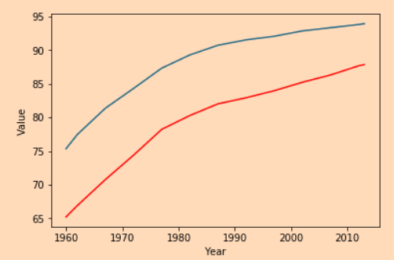
Comparison of survival of male vs. female
Blue-female
Red-male

Slide 4
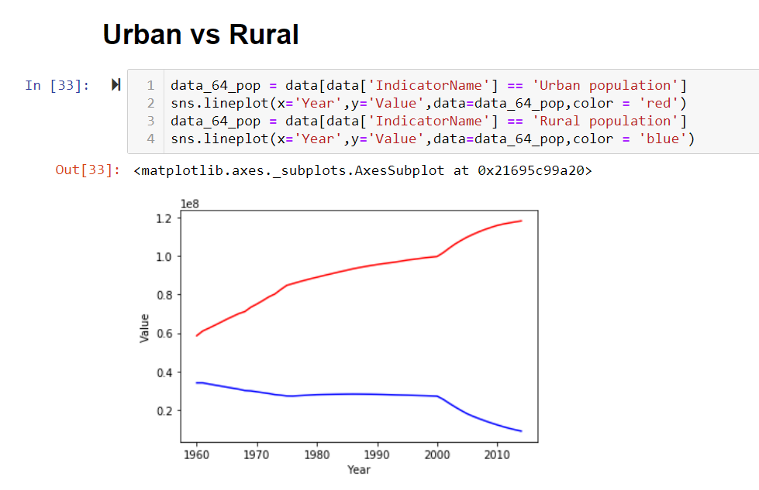

Slide 5
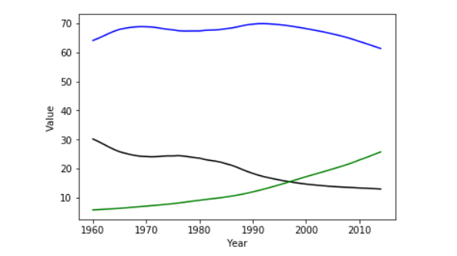
Age
Blue: Age 15-64
Black: Age 0-15
Green: Age 64+

Slide 6
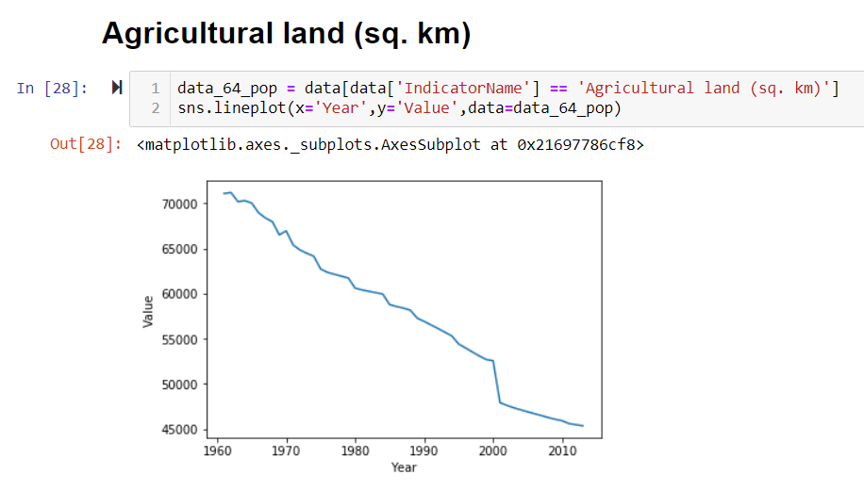

Slide 7
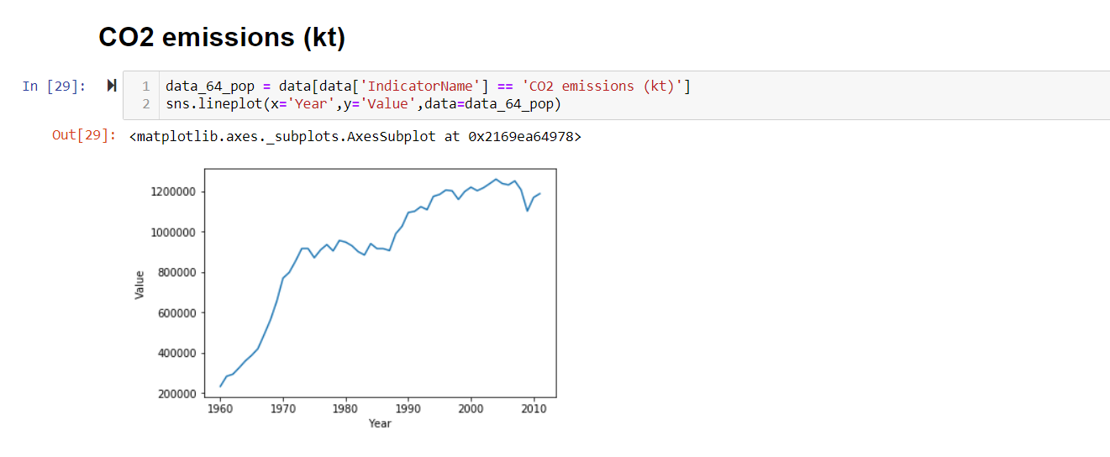
Due to decrease in agricultural land, there is an increase in the emission of CO2…!

Slide 8
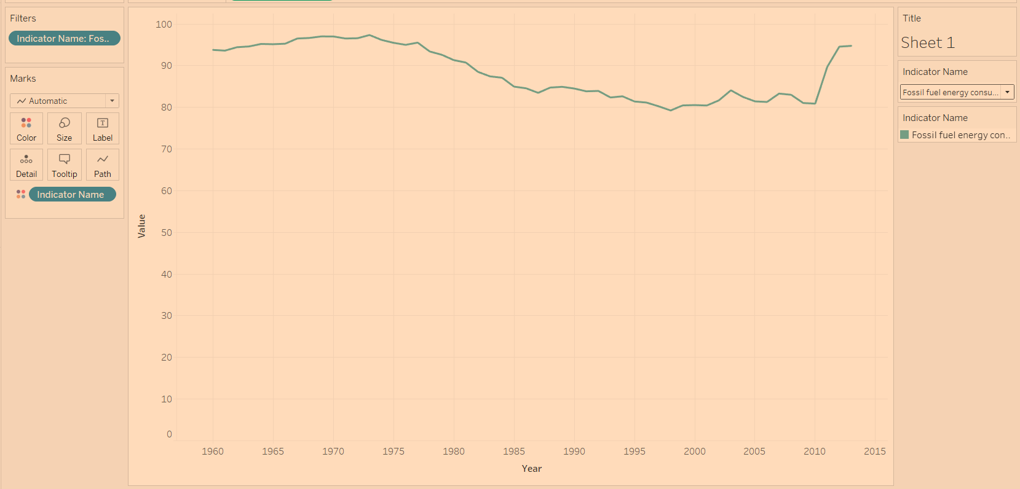
Consumption of Fossil Fuels

Slide 9
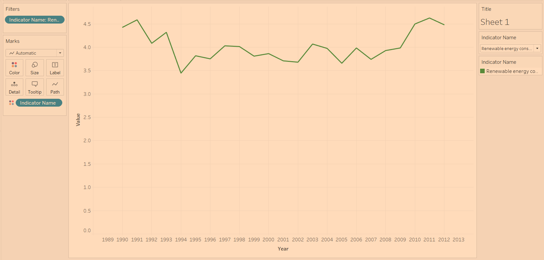
Renewable Energy Consumption

Slide 10
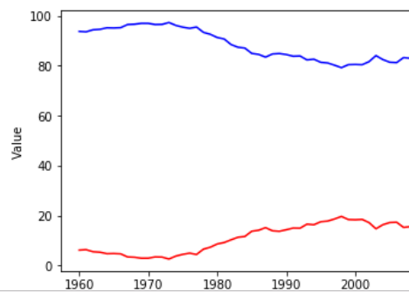
Fossil fuels consumption vs. Renewable energy consumption

Slide 11
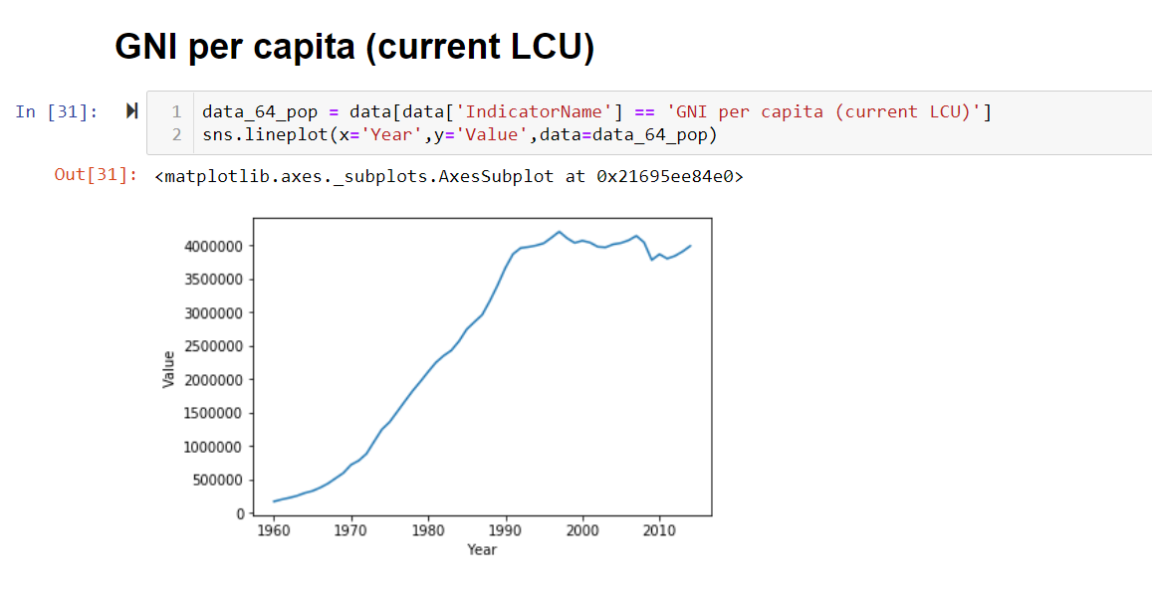
GNI

Slide 12
Conclusion
From the previous slides, we can conclude that the population of Japan is increasing which is causing in the decrease of agricultural land due to demand of urban population.
Emission of CO2 increased, hence resulting in more pollution.

Slide 13
Thank You!

